Slide 1
Head Injuries
Objectives
At the end of this lecture the medical student should be able to
Understand the mechanism of causation of head injuries
To describe head injuries in sequence from outside to interior

Slide 2


Slide 3
Causation of head injuries
Direct trauma – assault with club, fall from height, road traffic accidents
Indirect trauma – due to transmitted force ( blow to the chin, fall from height with feet striking the ground)
Acceleration, Deceleration movement of the head
Violent shaking

Slide 4
Head injuries
Scalp Injuries
Skull fractures
Intracranial haemorrhages
Brain damage

Slide 5
Scalp - Anatomy
S- Skin
C – Connective tissue
A- Aponeurosis
L – Loose areolar tissue
P - Pericranium

Slide 6
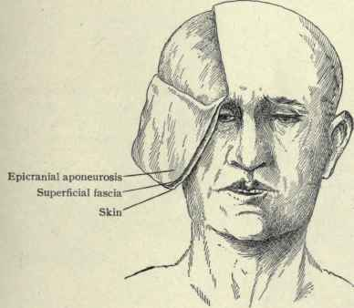
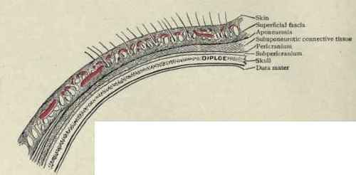
Scalp - Anatomy

Slide 7
Scalp injuries
Injuries may involve all or some layers
Scalp is very vascular and bleeds profusely
Common injuries
Abrasions
Contusions
Lacerations
Incised wounds
Fire arm injuries

Slide 8
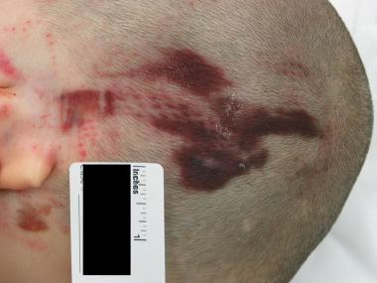
Abrasions
Less due to the head hair
Seen in bald persons and friction between scalp and a rough surface

Slide 9
Scalp Contusions
Difficult to detect until the hair is removed
Appear between the aponeurosis and the skin
Marked swelling is a common feature of extensive bruising
Bruise under the anterior scalp may slide down to appear in the orbit (Black eye)
Shape of an inflicting weapon is poorly produced in the scalp due to the padding effect of hair

Slide 10
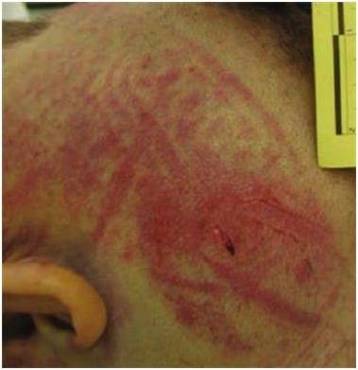
Scalp contusion

Slide 11
Scalp lacerations
Lacerated by an impact due to the underlying rigid skull
Blow from an instrument (hammer), fall against a hard object, impact against a blunt object cause a sharply defined split
Can be mistaken for an incised wound
Wound edges will show a narrow zone of bruising, hairs and fibrous strands crossing the depths of the wound

Slide 12
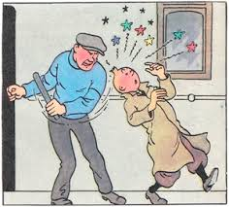

Slide 13
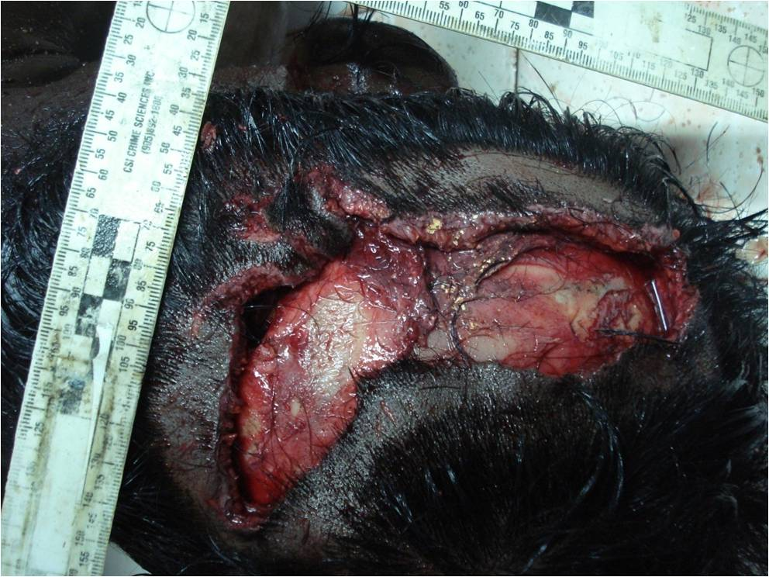
Scalp injuries – Blunt force trauma

Slide 14
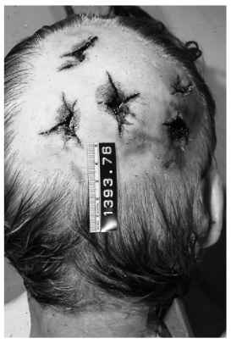
Scalp lacerations – Blow with an hammer

Slide 15
Scalp lacerations
Stellate – blunt rod
Linear – rod like objects
Y shaped- rod with a rounded end
Curved – blunt weapon with an edge

Slide 16
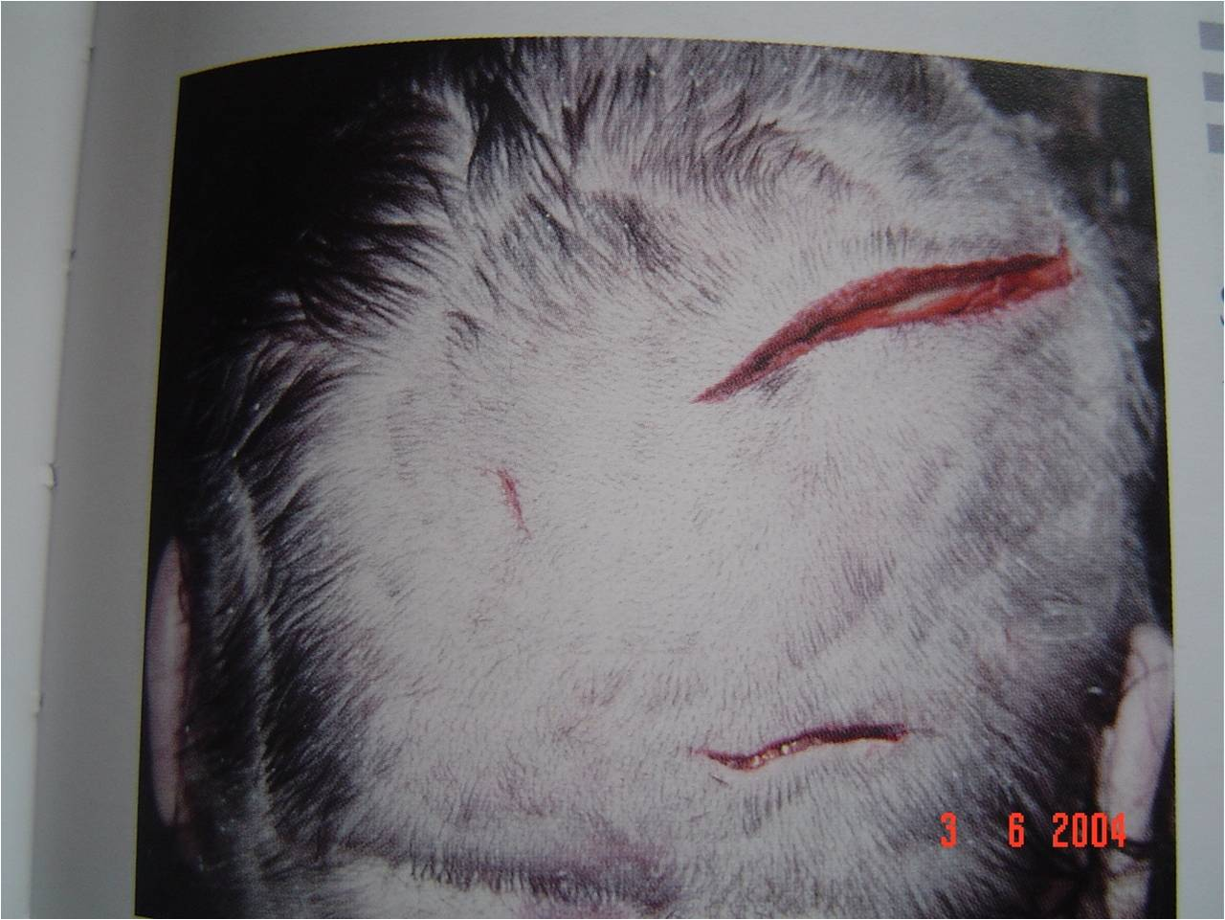
Incised wounds

Slide 17
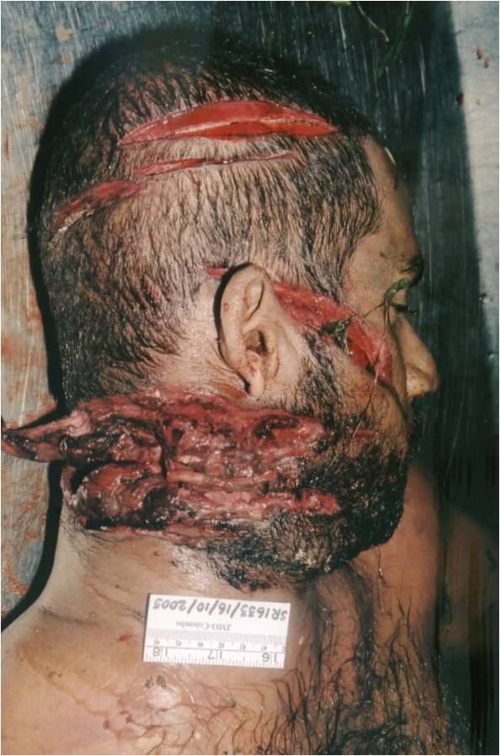
Incised wounds

Slide 18
Incised wounds
Slashed cut
Cut hair
Cut underlying tissues and bones
Regular margins
Cut ends showing tailing

Slide 19
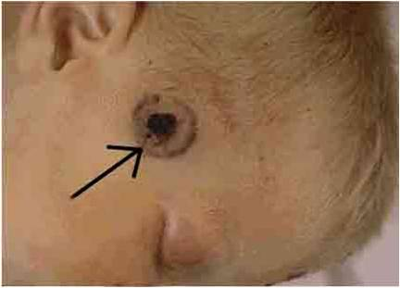
Firearm injuries

Slide 20
Firearm injuries
Perforating lacerations
Other features depending on entry, exit and range of firearm injuries

Slide 21
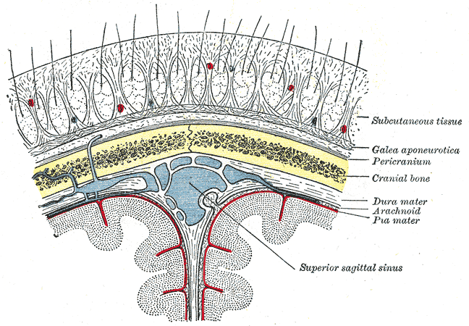
Skull Fractures – Forensic anatomy

Slide 22
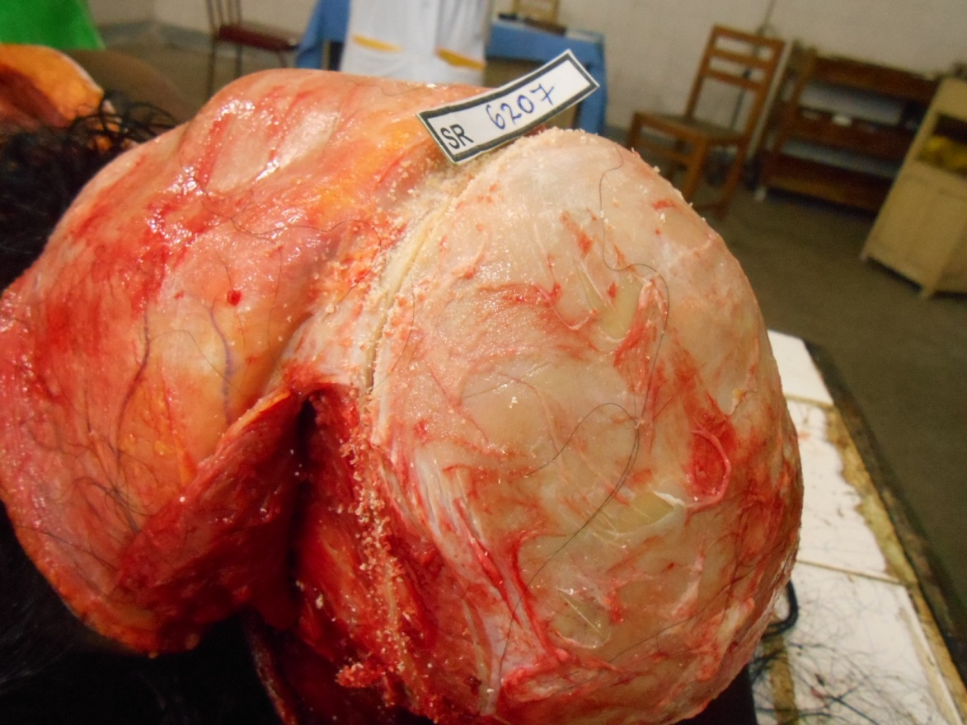
Forensic Anatomy - Skull

Slide 23
Mechanism of skull fractures
Impact causes distortion
Skull can withstand slight distortion but if this exceeds a certain limit fracture occurs
Skull fractures themselves are not fatal
Damage to the cranial contents is fatal
Fractured skull is an indication that a severe force was applied
Often indicate the position and nature of the head injury
Fracture usually corresponds to the point of impact

Slide 24
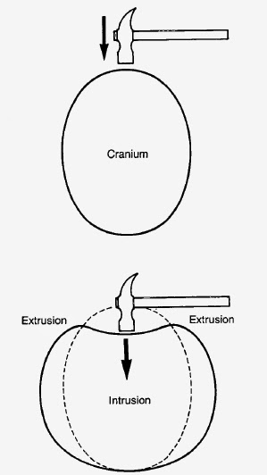
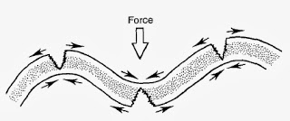
Struck hoop illustration

Slide 25
Struck hoop analogy
Impact makes skull deformed, intrustion and extrusion
skull is more susceptible to traction forces than compression so that convexities tend to fracture during the distortion of the ‘struck hoop’.
Break do not start at the point of impact, but initiated at a distance due to the compensatory deformation and usually run back towards the impact site.

Slide 26
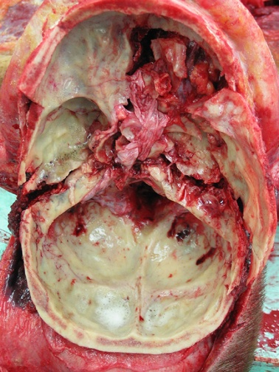
Hinge Fracture

Slide 27
Hinge Fracture
Blow or fall on the top or side of the head causing linear fractures commonly rundown the temparo-parietal plates.
These fractures run across the base of the skull often in the middle cranial fossae and pituitary fossae.
These base of the skull fractures may separate the base of skull into two halves called the ‘hinge fracture.’ Eg: RTA

Slide 28
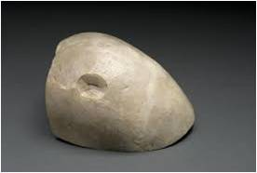
Depressed Fracture

Slide 29
Depressed fracture
Due to a focal impact which drives the fragments inside
Caused by weapons with a small striking surface eg; hammer
May damage the meninges, vessels or brain tissue
Later may gives rise to traumatic epilepsy

Slide 30
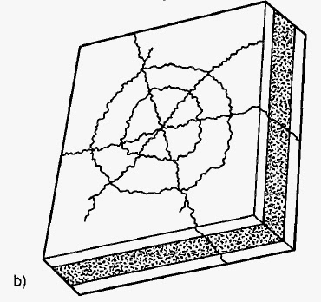
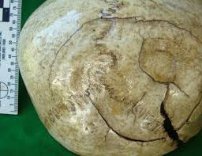
Mosaic or spider’s web fracture
Depressed or not fractures from a focal impact may show radiating lines
Sometimes joined by concentric circles in a ‘spider web’ pattern

Slide 31
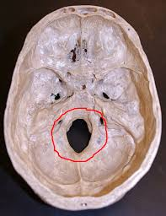
Ring Fracture
Fall from height on to the top of the head or to the feet ‘ring fracture’ may be seen
Encircles the foramen magnum due to the skull and cervical spine being forced together

Slide 32
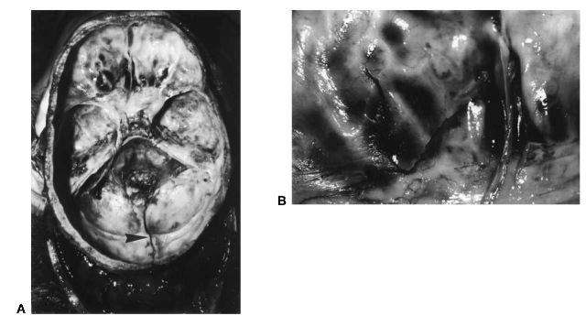
Contre-coup fractures
Seen in roof of orbits, and ethmoidal plates following occipital impacts

Slide 33
Intracranial haemorrhage
Extra dural haemorrhage
Sub dural haemorrhage
Sub arachnoid haemorrhage

Slide 34
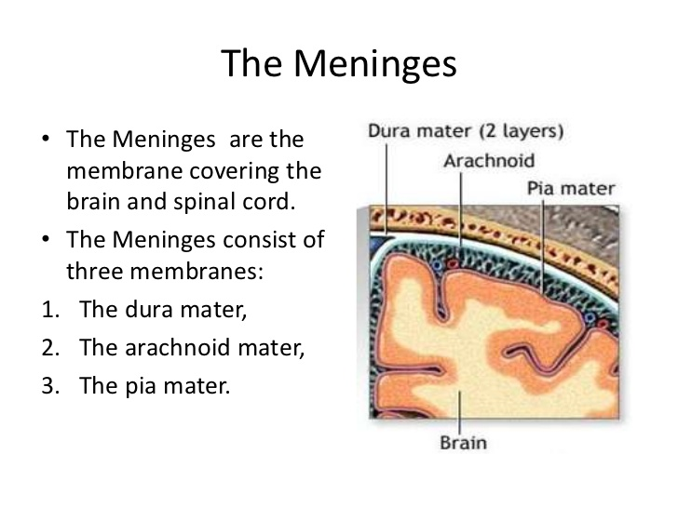
Anatomy of brain membranes

Slide 35
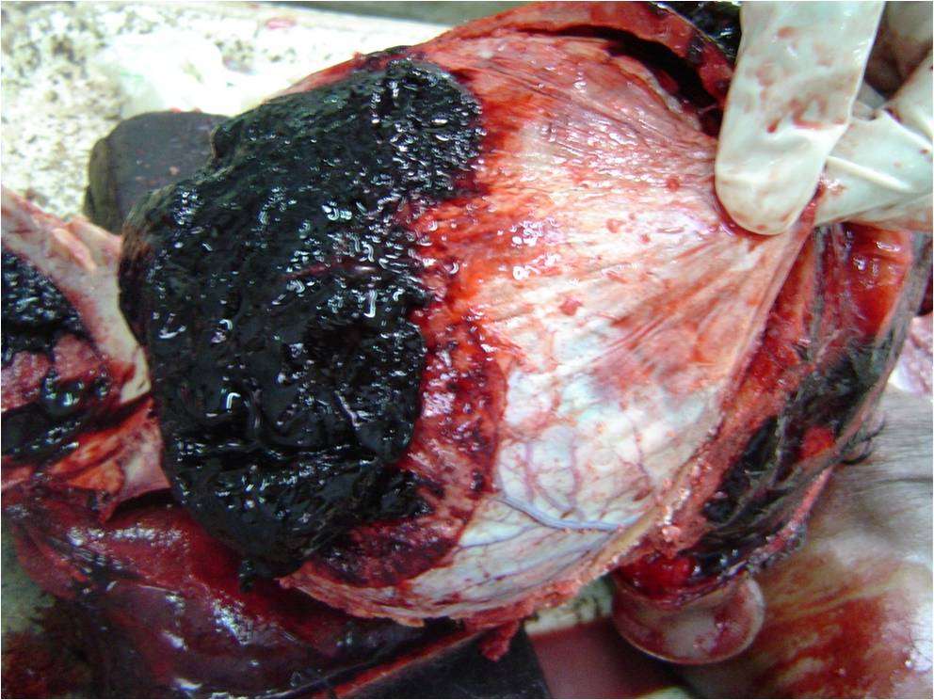
Extradural haemorrhage

Slide 36
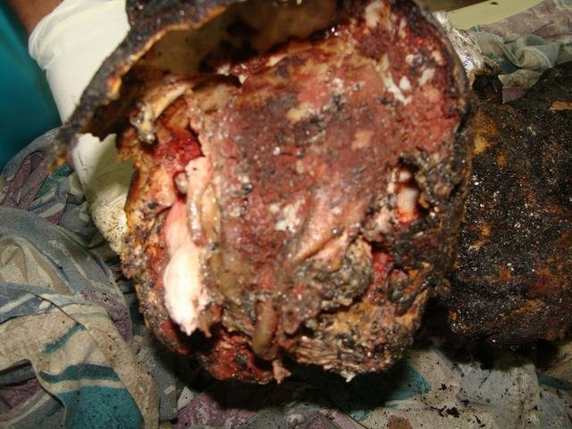
Heat haematoma ( Post mortem artefact)

Slide 37
Extradural haemorrhage
Usually associated with a fracture of the skull
Blood escapes from a meningeal artery
Blood forms a haematoma which strips away the dura from the skull to form a space occupying lesion (SOL)
Flattening of the underlying parietal lobe, cerebral oedema, hippocampal herniation and coning of the cerebellar tonsils can occur due to the SOL.

Slide 38
Clinical picture
Temporary concussion
Lucid interval of consciousness
Relapse into coma

Slide 39
Subdural haemorrhage
Acute
Occurs in the absence of a fractured skull
In infants it can occur solely from vigorous shaking
Bleeding comes from the communicating veins which cross the subdural space
Any rotational or shear force can tear the veins
Chronic
In old persons may be found at autopsy as an incidental finding

Slide 40
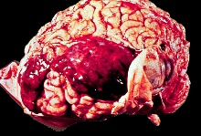
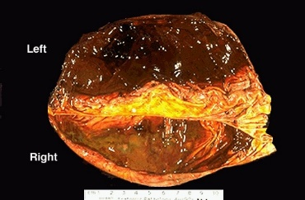
Acute and Chronic subdural haematoma

Slide 41
Sub dural haemorrhage
Chronic
A gelatinous membrane forms around the haematoma which may harden into a dense rubbery capsule in the chronic stages

Slide 42
Subarachnoid haemorrhage
Common wherever brain damage has been caused
May also occur without injury to the cerebral tissue
Mostly pure subarachnoid bleeding is due to natural causes – ruptured berry aneurysm
Traumatic subarachnoid haemorrhage – bleeding can occur from the vertebra-basilar vessels in the posterior cranial fossae where a person suffers a kick or heavy blow to the side of the neck

Slide 43
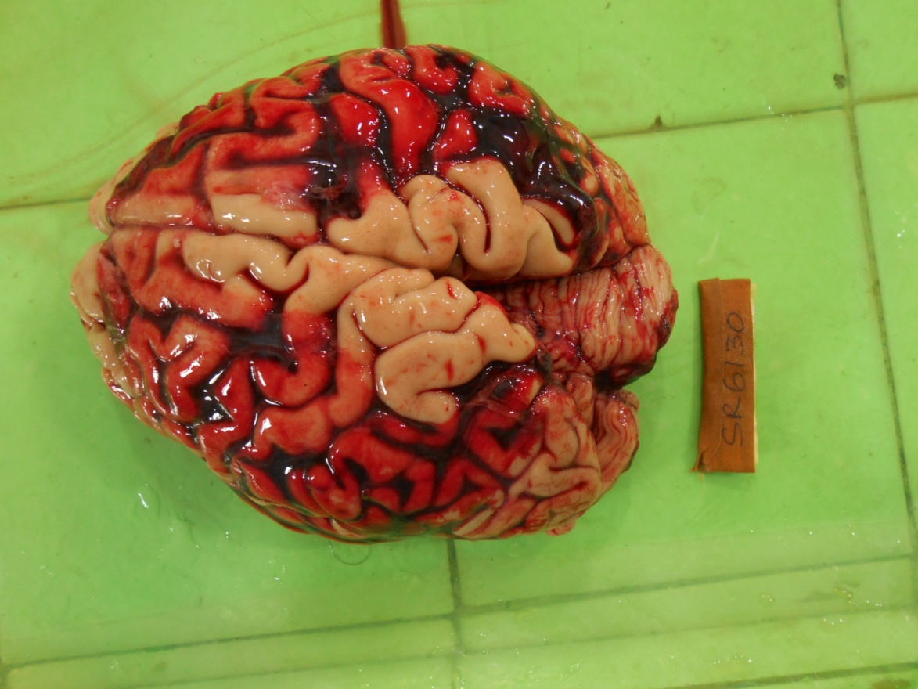
Sub arachnoid haemorrhage

Slide 44
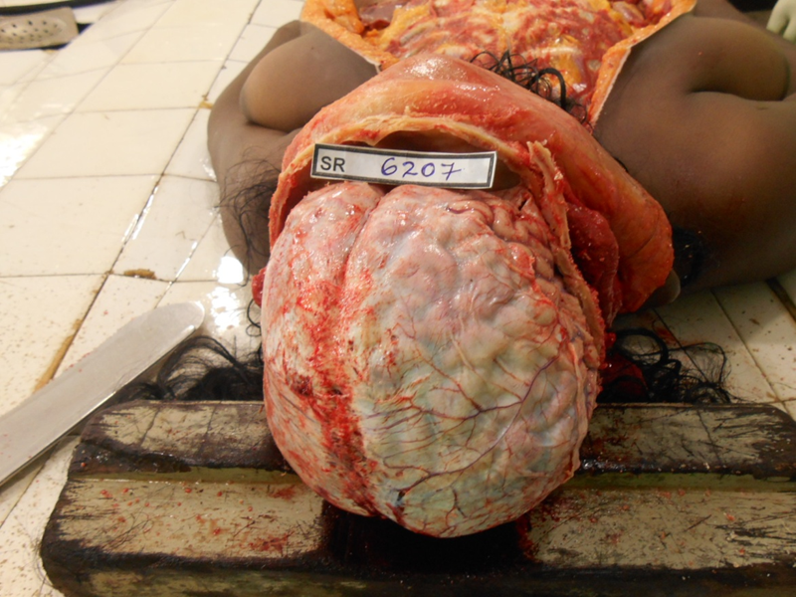
Brain - Anatomy

Slide 45
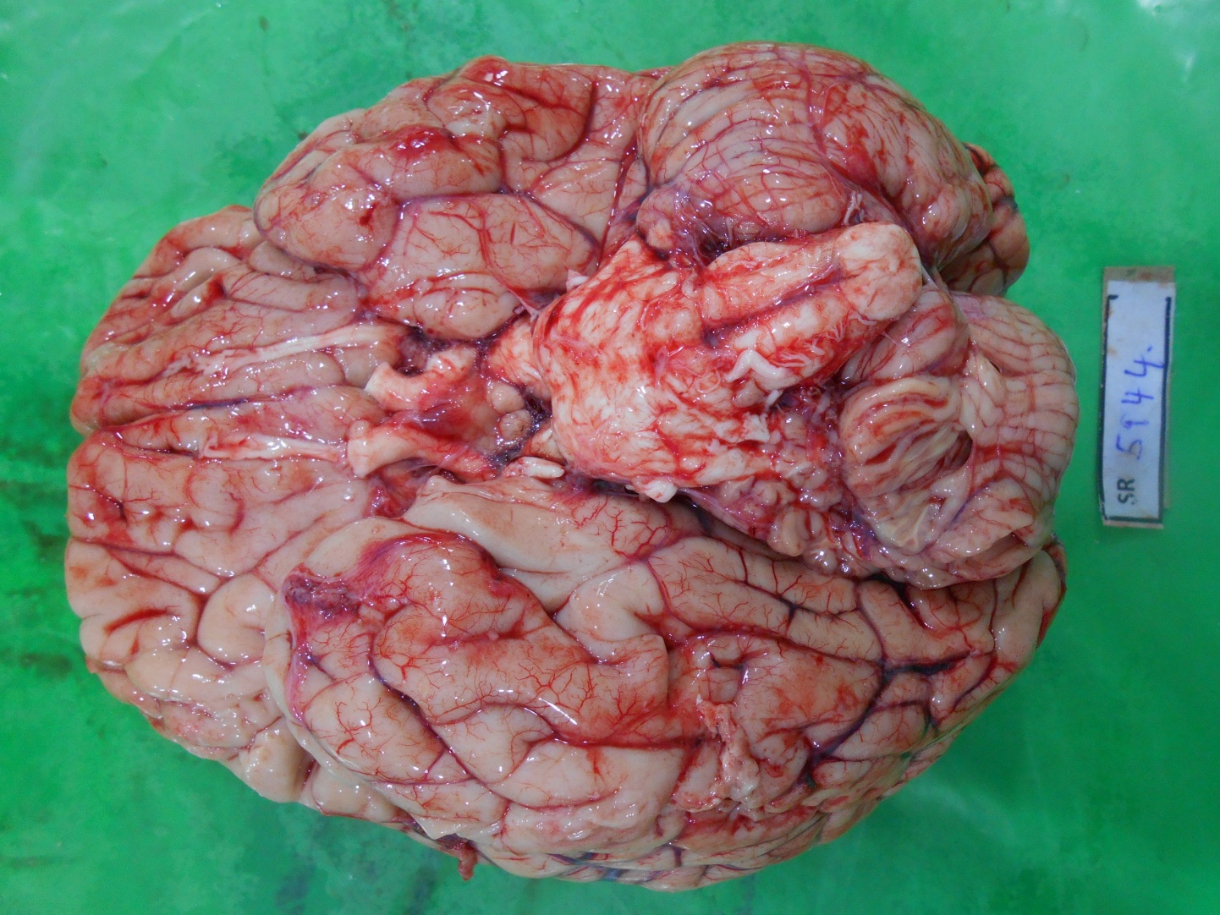
Normal Brain - Anatomy

Slide 46
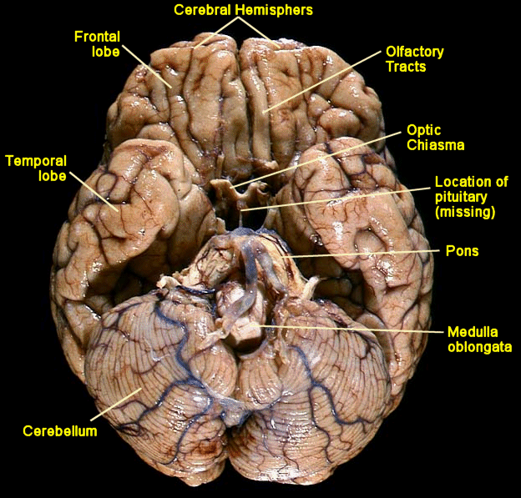

Slide 47
Brain injuries - Cerebral oedema
Common and a rapid sequel to head injury
Cause death by raised intracranial pressure with secondary effects to the brain stem
Gyri expand, sulci fill up resulting in the flattening of the cerebrum
Cerebellum and brainstem are forced into the foramen magnum
Hippocampal gyrus herniates through the opening in the tentorium cerebelli

Slide 48
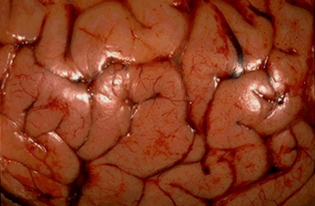
Cerebral oedema

Slide 49
Diffuse Axonal Injury (DAI)
Lesions are due to shearing stresses within the soft brain substance
Axons of neurons become broken and within hours spherical retraction balls form
Demonstarble by special stains histologically
Neurons may recover but many will degenerate
Certain parts of the brain more prone to DAI
Eg: Corpus callosum, parts of the cortex and brain stem

Slide 50
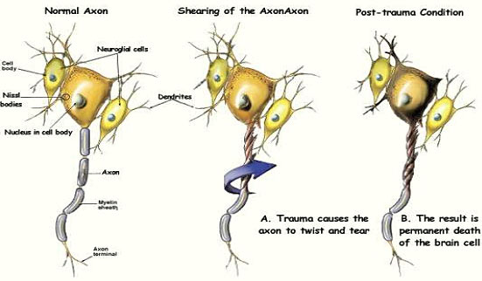
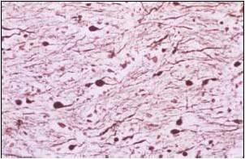

Slide 51
Cerebral Contusion and laceration
Mechanical damage to the brain substance and may occur anywhere in the cerebral hemisphere
Depressed skull fractures or penetrating head injuries may directly injure the cortex
Rotation, acceleration, deceleration are necessary for brain damage to occur

Slide 52
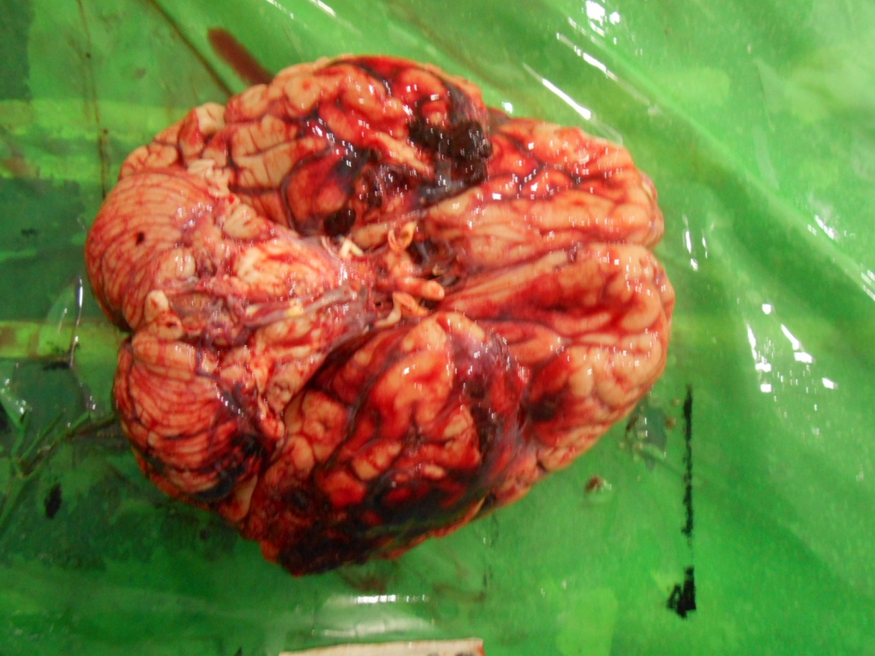
Brain injuries

Slide 53
Coup and contre-coup injuries
Coup injuries- they are found directly under the external injury
Contre-coup injury – Injuries found opposite to the external point of impact.
Greater severity than coup injuries and occurs when the head is free to move. Eg: Falling backwards
Common in the frontal and temporal areas (apical and inferior surface)
Often associated with a SAH and SDH

Slide 54
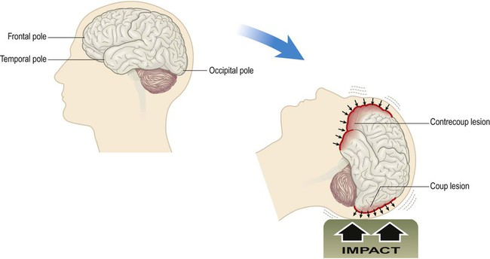

Slide 55
Reference
Knight’s Forensic Pathology 3rd edition
Lecture Notes in Forensic Medicine Volume I
By Dr. L.B.L.De Alwis
Simpson’s Forensic Medicine by Bernard Knight
The pathology of trauma by JK. Mason

Slide 56
THANK YOU

